Slide 1
GAME THEORY

Slide 2
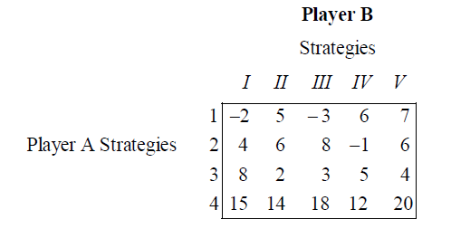
Problem 1:
Solve the game with the following pay-off matrix.

Slide 3
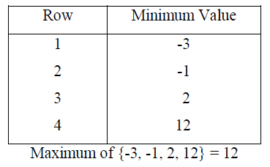
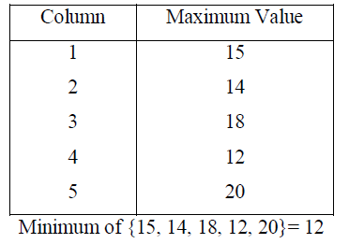
Solution:
First consider the minimum of each row.
We see that
the maximum of row minima = the minimum of the column maxima. So the game has a saddle point. The common value is 12. Therefore the value V of the game = 12.
Next consider the maximum of each column.
Interpretation:
In the long run, the following best strategies will be identified by the two players:
The best strategy for player A is strategy 4.
The best strategy for player B is strategy IV.
The game is favourable to player A.

Slide 4
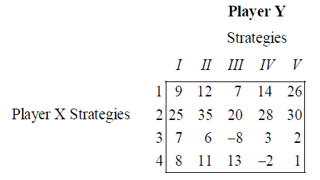
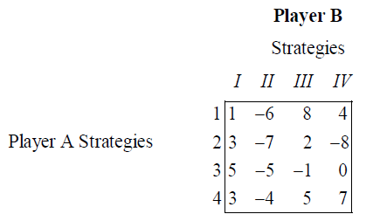
Problem 2:
Solve the game with the following pay-off matrix
It is observed that the maximum of row minima and the minimum of the column maxima are equal. Hence the given the game has a saddle point. The common value is 20. This indicates that the value V of the game is 20.
Problem 3:
Solve the following game:
Since the max {row minima} = min {column maxima}, the game under consideration has a saddle point. The common value is –4. Hence the value of the game is –4.
Interpretation.
The best strategy for player A is strategy 4.
The best strategy for player B is strategy II.
Since the value of the game is negative, it is concluded that the game is favourable to player B.

Slide 5
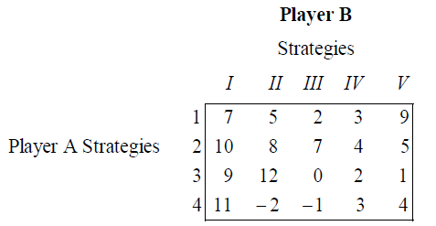
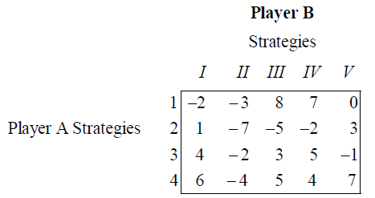
Solve the game with the following pay-off matrix.
Solve the game with the following pay-off matrix.
Answer:
Best strategy for A: 2
Best strategy for B: IV
V = 4
The game is favourable to player A
Answer:
Best strategy for A: 3
Best strategy for B: II
V = -2
The game is favourable to player B

Slide 6
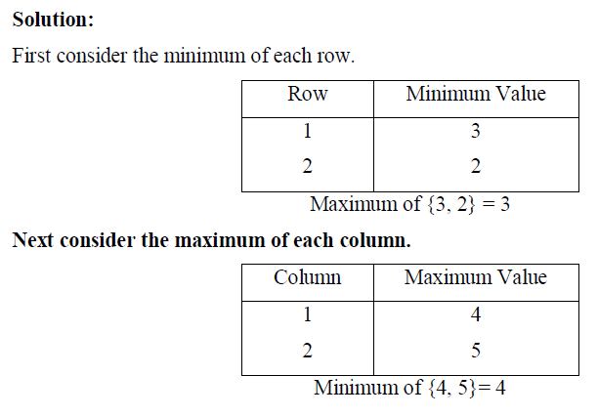
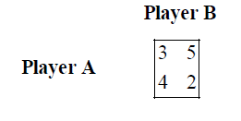
Problem 1:
Examine whether the following 2 x 2 game has a saddle point
GAMES WITH NO SADDLE POINT
We see that max {row minima} and min {column maxima} are not equal. Hence the game has no saddle point.

Slide 7
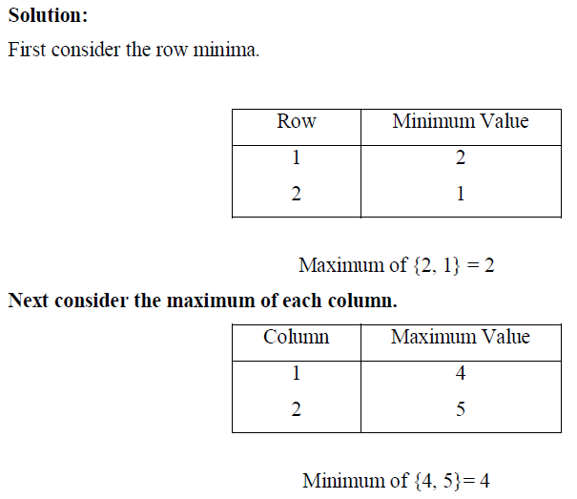
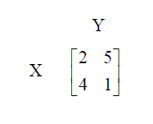
Problem 2:
Solve the following game
We see that
Max {row minima} ≠ min {column maxima}
So the game has no saddle point. Therefore it is a mixed game.

Slide 8
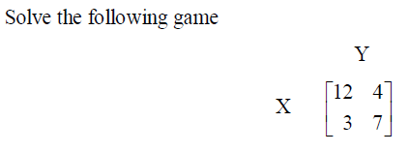
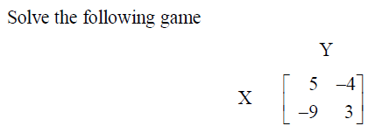
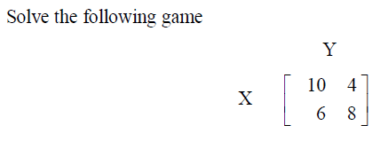
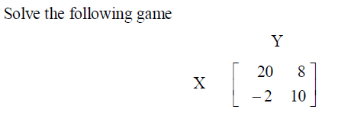
Answer: p = 1/3, r = 1/4, V = 6
Answer: p = 4/7, r = 1/3, V = -1
Answer: p = 1/4, r = 1/2, V = 7
Answer: p = 1/2, r = 1/12, V = 9

Slide 9
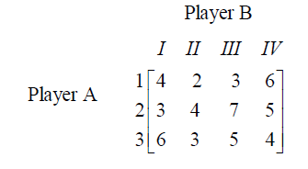
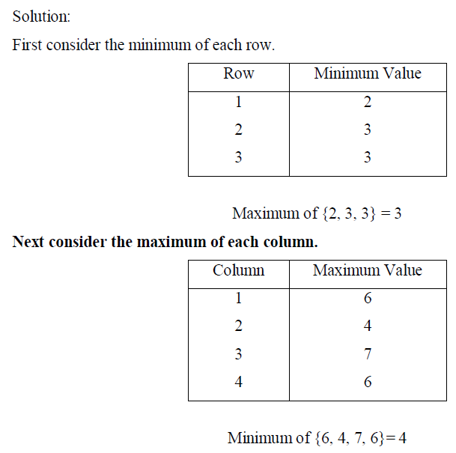
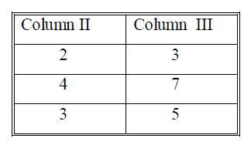
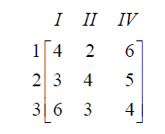
THE PRINCIPLE OF DOMINANCE
Problem 1:
Solve the game with the following pay-off matrix:
The following condition holds:
Max {row minima} ≠ min {column maxima}
Therefore we see that there is no saddle point for the game under consideration.
Compare columns II and III.
We see that each element in column III is greater than the corresponding element in column
II. The choice is for player B. Since column II dominates column III, player B will discard
his strategy 3.
Now we have the reduced game

Slide 10
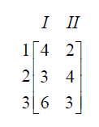

For this matrix again, there is no saddle point. Column II dominates column IV. The choice
is for player B. So player B will give up his strategy 4
The game reduces to the following:
This matrix has no saddle point.
The third row dominates the first row. The choice is for player A. He will give up his
strategy 1 and retain strategy 3. The game reduces to the following:
Again, there is no saddle point. We have a 2x2 matrix.
The value of the game, V=15/4
Thus, X = (3/4 , 1/4 ,0,0)
and Y = (1/4 , 3/4 ,0,0)
are the optimal strategies.

Slide 11
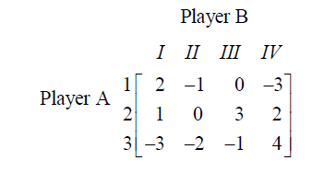
Problem
For the game with the following pay-off matrix, determine the saddle point
We see that
Maximum of row minimum = Minimum of column maximum = 0.
So, a saddle point exists for the given game and the value of the game is 0.
Interpretation:
No player gains and no player loses. i.e., The game is not favourable to any player. i.e. It is a fair game.

Slide 12
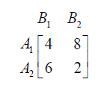
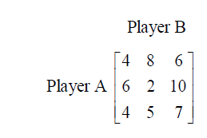
Problem:
Solve the game
Solution:
Now the given game is transformed into the following game.
Value of the game is V = 5
Thus, A = (3/4 , 1/4 ,0)
and B = (1/2 , 1/2 ,0)
Interpretation
Out of 3 trials, player A will use strategy 1 once and strategy 2 once. Out of 3 trials, player B will use strategy 1 once and strategy 2 once. The game is favourable to player A.

Slide 13
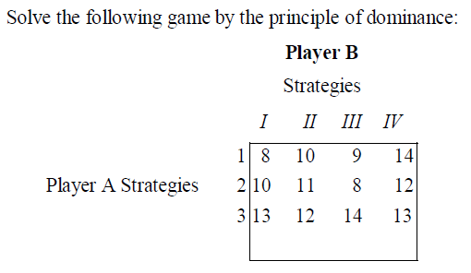
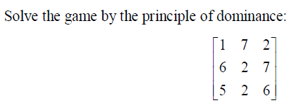
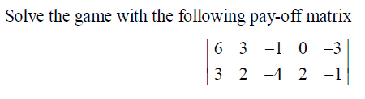
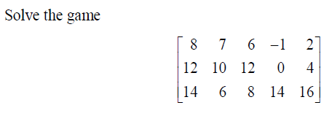
Answer: V = 12
Answer: V = 4
Answer: p=3/5 , r=2/5 , V=11/5
Answer: p=4/9 , r=7/9 , V=70/9

Slide 14
Reference
http://www.pondiuni.edu.in/storage/dde/downloads/mbaii_qt.pdf

